Slide 1
Lists with CodeBot
A supplemental lesson for AP CSP

Slide 2
Warm-up
You used a list in two programs during Mission 6:
CheckLines
  List: detected
LineFollow1
  List: sensors
  Tuple (similar to a list): vals
Open the programs and review how the lists were used in each program.

Slide 3
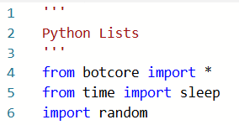
Using a List: Getting Started
Create a new program that will define and use a list.
Use the sandbox.
Start a new file PythonLists1
Import the botcore, time and random libraries.

Slide 4

Using a List: Getting Started
Define your first list
Define a list of frequencies for a CodeBot beep.
  You can have as many frequencies as you want (the list can be of any length).
  Lists are usually defined near the top of code.

Slide 5
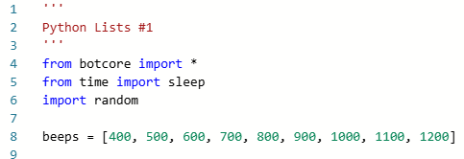
Using a List: Getting Started
This code segment shows an example of the beeps list. Your list can have different frequencies than the ones shown, and a different number of frequencies.

Slide 6
Using a List: Example #1
In your practice with lists, you learned how to access a single element in a list using an index.
Write a function that access an element in a list using its index.
Functions are usually defined just below global variables and lists.
Include a comment that describes what this function does.

Slide 7
Using a List: Example #1
This function will use the counting function from the SweepLEDs program (Animatronics).
Open the program and review the if statement used for counting and the function it calls to count the number of guests.

Slide 8
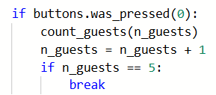
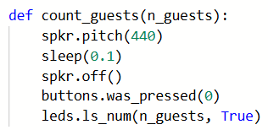
Using a List: SweepLEDs
If statement used for counting guests:
Function it calls:

Slide 9
Using a List: Example #1
Copy and paste both the if statement and the function into the PythonLists1 program.
Use a while True: loop in the Main Program.
Run the code and make sure it works before continuing to the next step.

Slide 10
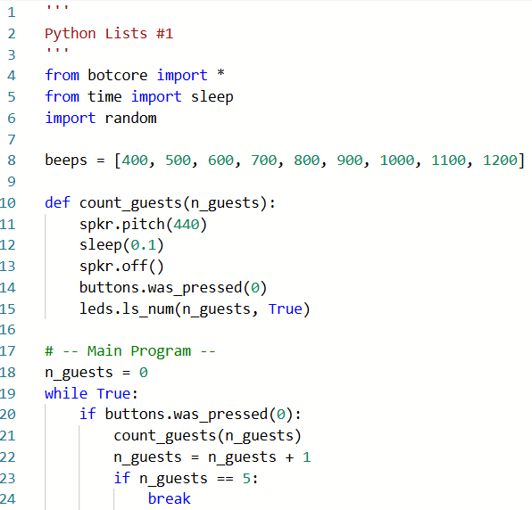
Using a List: Example #1

Slide 11
Using a List: Example #1
Now combine the code in the main program with the function, so you have one function, and call that one function in the main program.
No parameter is needed.
Run the code and make sure it works before continuing to the next step.

Slide 12
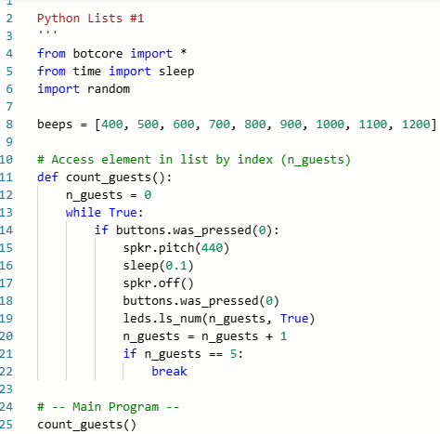
Using a List: Example #1

Slide 13
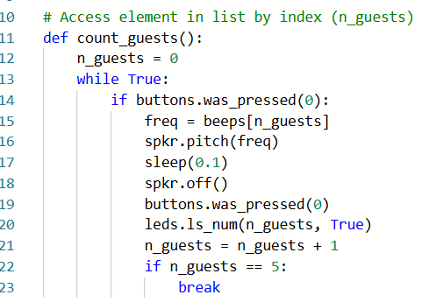
Using a List: Example #1
In the function, get a beep from the list.
Replace the (440) in spkr.pitch() with a beep from the list, using the index.

Slide 14
Using a List: Example #1
Run the code. Press BTN-0.
You should see the LEDs light in order, and the beeps play in order.

Slide 15
Using a List: Example #2
Let’s access an element in a list a different way – randomly.
Define another function for this task.
This function will not require the user to push a button; it will just play random beeps.
Include a comment that describes what this function does.

Slide 16
Using a List: Example #2
Algorithm:
Initialize a count variable to 0
Start a while loop
Get a random number for the index
Use the random number to access an element in the list
Use the element to sound a beep
Increment the count variable
Try writing this code on your own.

Slide 17
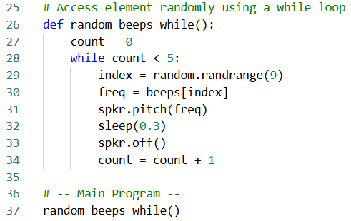
Using a List: Example #2
Your code should look similar to this.
You decide the length of the while loop.
You decide the random number range for the index. I used the length of my list.

Slide 18
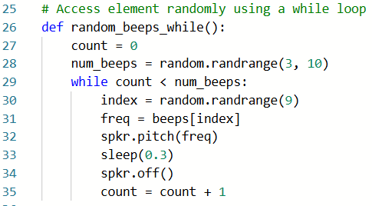
Using a List: Example #2
Changes we can make:
Get a random number for the while loop
You decide the range for the random looping

Slide 19
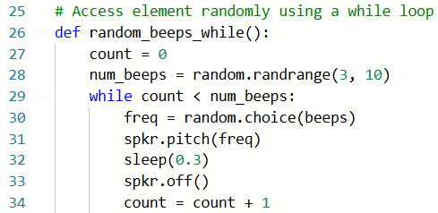
Using a List: Example #2
Changes we can make:
The random library has a method that selects a random element in a list.
Use this method to reduce code.

Slide 20
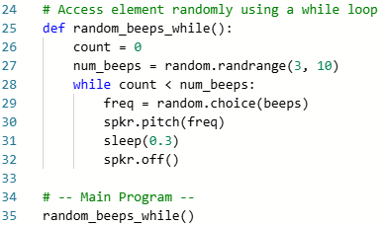
Using a List: Example #2
Change the main program to call this function.
Run the code several times.
You should hear random beeps. If a beep is longer, it was randomly selected twice in a row.

Slide 21
Using a List: Example #3
Let’s access an element in a list randomly, using a different control structure.
Replace the while loop with a for loop.
A for loop is a specialized while loop that embeds the counter so you don’t have to code it.
Define another function for this example.
Include a comment that describes what the function does.
The code will be almost exactly the same as the last function, but you don’t need a count variable defined and incremented.

Slide 22
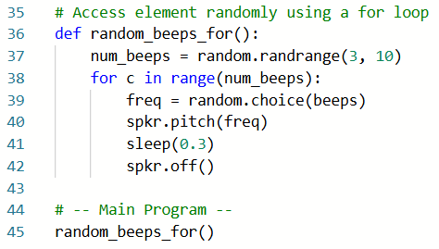
Using a List: Example #3
Notice how similar the two functions are.
The for loop shortens the code by 2 lines, and also eliminates the possible error of forgetting to increment the counter.

Slide 23
Using a List: Example #3
Change the main program to call this function.
Run the code several times.
You should hear random beeps. If a beep is longer, it was randomly selected twice in a row.

Slide 24
Using a List: Challenge
You now have three ways to use a list in a CodeBot program:
Accessing an element by index
Accessing an element randomly using a while loop
Accessing an element randomly using a for loop
Use this program as your own personal library. When you need to use a list and access an element, you can refer to this code, if needed.

Slide 25
Using a List: Challenge
Give it a try!
Open the SweepLEDs program from Mission 4.
Define (create) a list of beeps.
Choose one:
  Modify the count_guests() function to access a beep using its index when a guest is counted.
  Modify the count_guests() function to access a beep randomly when a guest is counted.

Slide 26
Wrap Up
  Submit the PythonLists1 program and the modified SweepLEDs program to your teacher.
  Complete the wrap-up questions in the assignment.

